Slide 1
Market research results
Presented by: Gabriel Hu

Slide 2
General findings
From all available location types, Restaurant is the most popular location type
62% of locations are not in a chain
Sunset Blvd has the most restaurants in the LA
Chains generally have many establishments with a small number of seats
Average number of seats varies per location type, Restaurant having 48 seats on average.

Slide 3
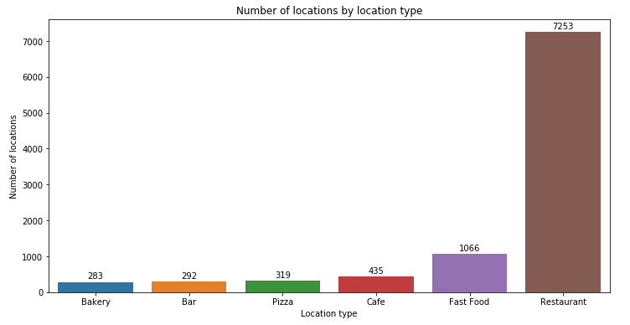
Restaurant has the biggest number of locations
As seen on the graph, the biggest number of locations is the restaurant type.
The difference between restaurant and fast food is huge as well, with a difference of over 6000 location differences.

Slide 4
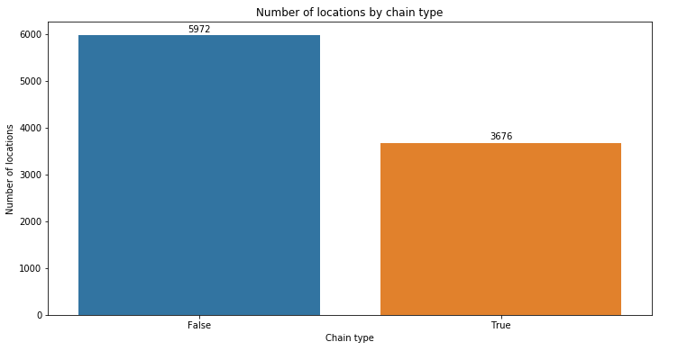
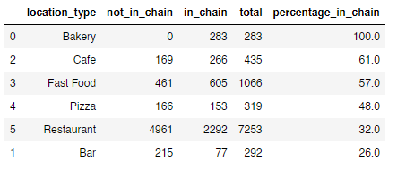
Restaurants are mostly not in a chain
100% of Bakery's are in a chain, with Cafes and Fast Food also being mostly in chain as well.
32% of restaurants are in a chain, we should consider NOT being in a chain.

Slide 5
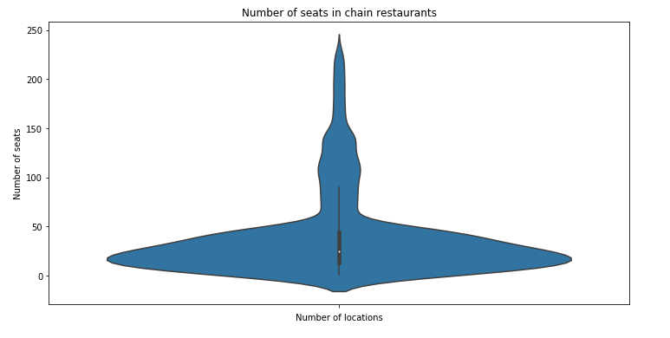
Chains generally have many establishments with a small number of seats
Most locations sit around 20 seats.
It’s more typical to have a lower number of seats with more establishments.

Slide 6
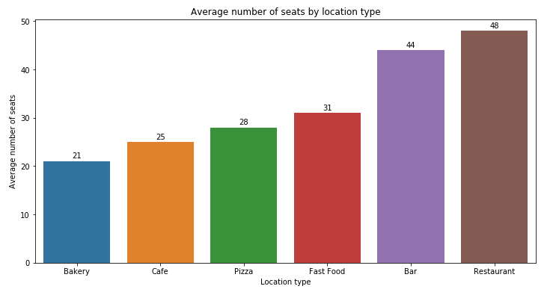
Average number of seats in a Restaurant is 48
On average, the Restaurant location type has the most average number of seats, sitting at 48 seats.
The Bar location type takes second place with 44 on average, with a bigger gap at Fast Food with 31 sitting in third.

Slide 7
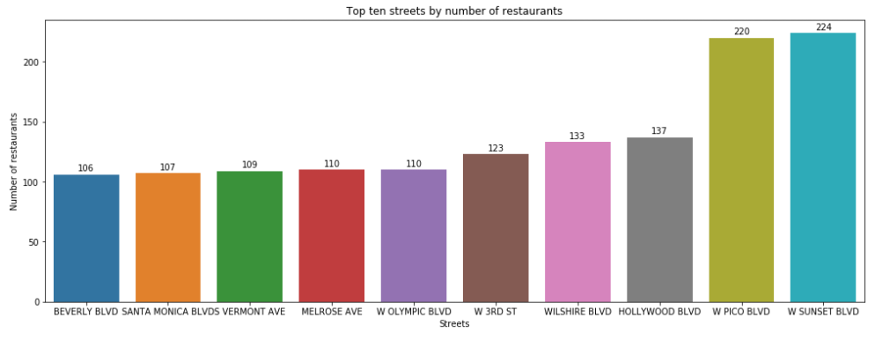
Top locations to consider for restaurants is Sunset Blvd and Pico Blvd
The top two locations are Sunset Blvd and Pico Blvd, and due to the number of restaurants being so close together, both are valid options.
These two locations are so far ahead from the other locations by a large margin and are seriously worth considering.

Slide 8
General conclusions
We should consider the restaurant location type
We should be located in either Sunset Blvd or Pico Blvd
We should have 48 seats for the restaurant.
Considering that only 32% of restaurants are in a chain, we should consider NOT being in a chain.

